Slide 1
GOLD SHOP MANAGEMENT SYSTEM
MEMBERS OF JAVANESE
Amin Nurul | 1630645
Hasan Md Tanvir | 1716763
Yahia Siddique | 1639835
Shariful islam | 1619061
Zannat Nahrin | 1632738
Rakibul Islam | 1520173

Slide 2
SUMMARY
The tasks of this system is to manage the records of sell ,inventory and employee list and bill creation. The sell option is only for creating bills. Our java program shows two options when the program opens those are Sell and admin page.
After pressing the sell option inventory will be visible and employee can create bills. In admin page the admin can update and check employee list, sells list, help ,change password. Data are being kept in a database. Admin can load any data at real-time from database. We created 8 buttons in total for this project.

Slide 3
Project Scope
Easy to handle.
Don’t need any other tool except Java to run this system.
User experienced GUI
Secured
Organized database

Slide 4
User
Manager of the shop
Verified employee of the shop

Slide 5
Lessons learned from the project:
How to create interface using java.
How to do the coding part.
How can you use the billing system.
We face some troubles regarding the project and we take help from youtube and google. So this will help us to increase our knowledege.
We can implement this in further processes like making other system easily, or improve this system take it to the another level. Make it more complex and user friendly.
We have learned how to use inheritance. Also how to create subclass and superclass

Slide 6
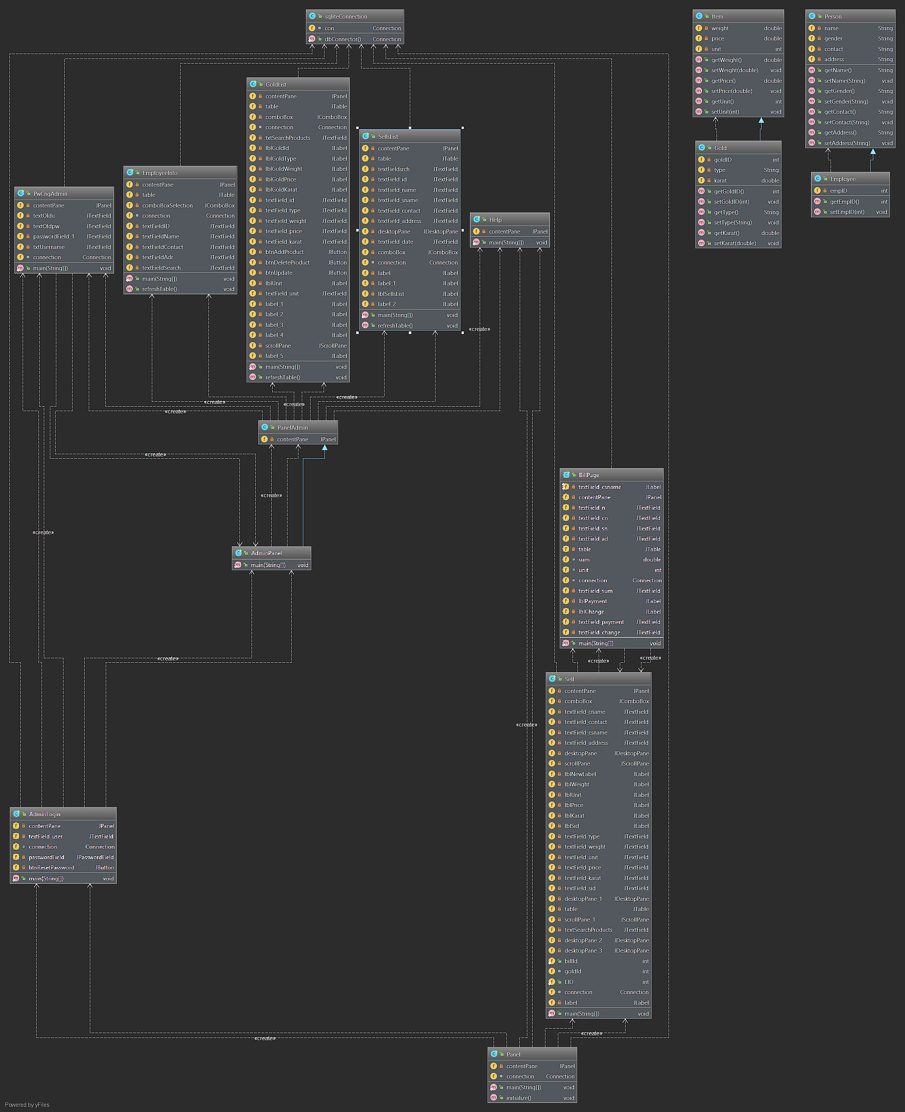
UML

Slide 7
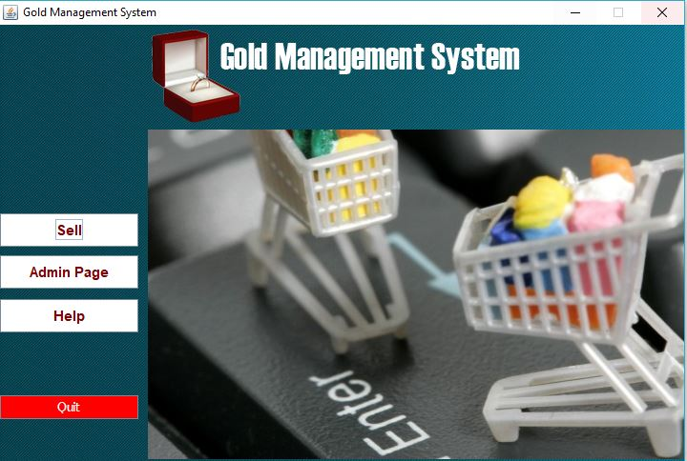
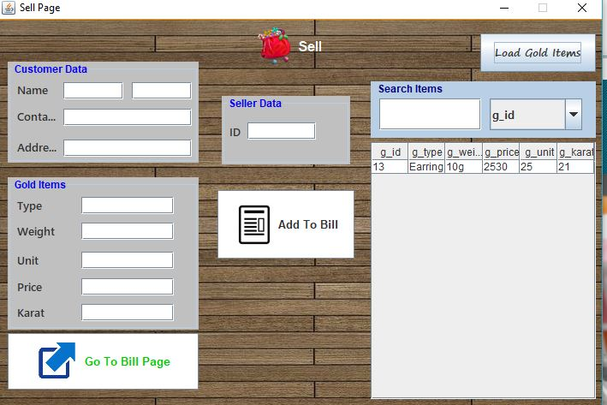
Interface

Slide 8
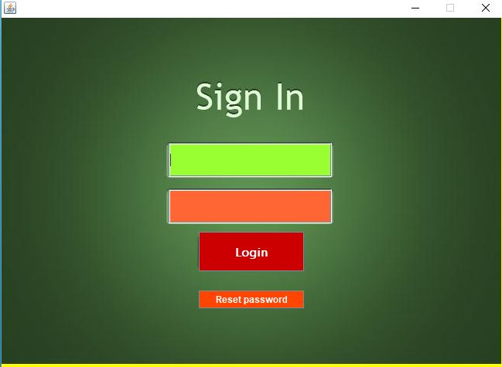
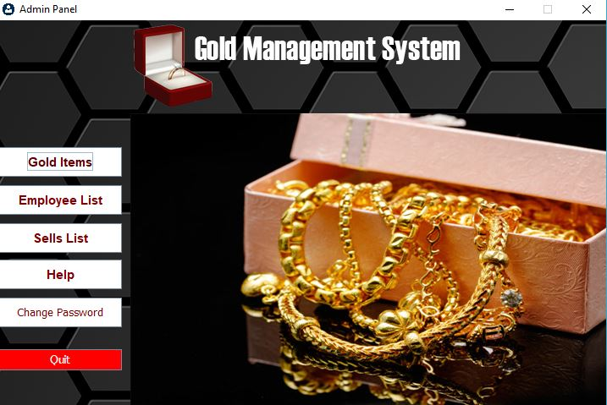
Interface Contd.

Slide 9
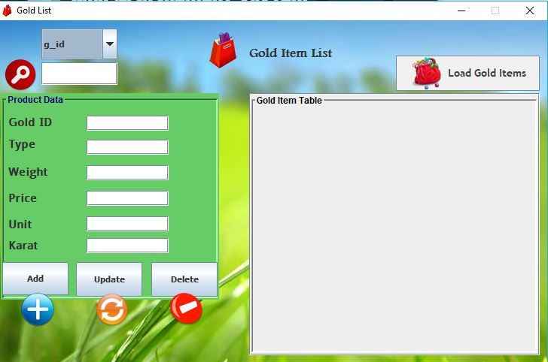
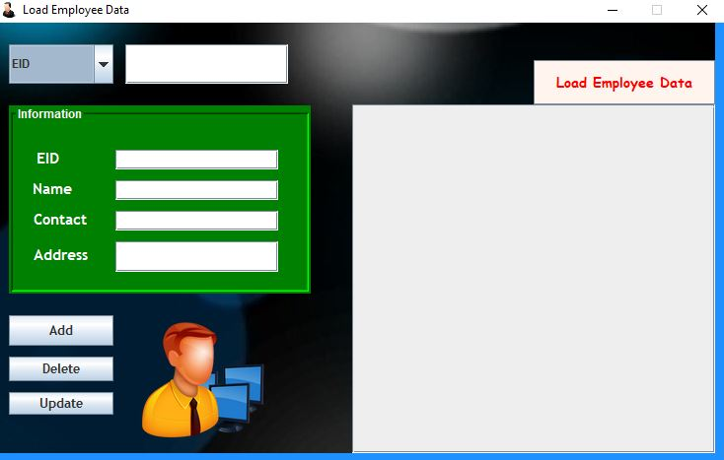
Interface Contd.

Slide 10
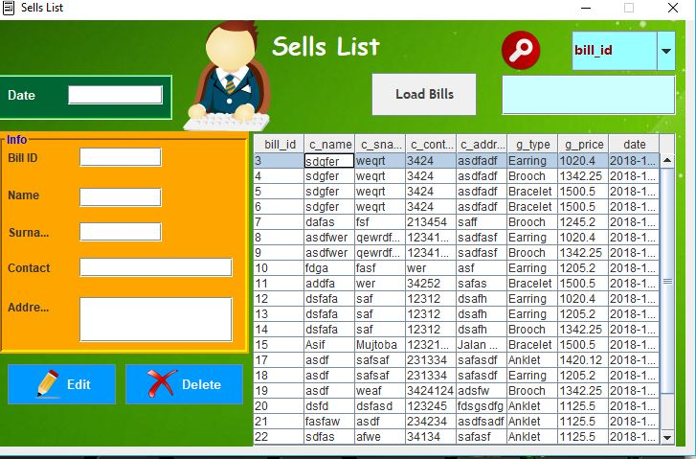

Interface Contd.

Slide 11
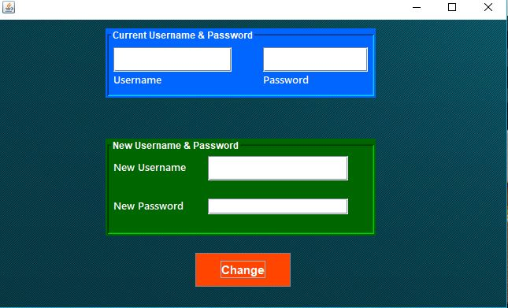
Interface Contd.

Slide 12
THANK YOU

